Slide 1
D: Initial Uncertainty Analysis for Water and Energy Sectors
Robert Lempert, RAND
Nicholas Burger, RAND

Slide 2
Outline
Rob describes:
  Range of climate data we are using in this study
  RDM analyses
  RDM analysis using WEAP model of climate impacts on Volta (and Orange-Senqu) basins
Nick describes:
  Energy robustness analysis

Slide 3
Traditional Decision Methods Make Sense
If We Don’t Face Much Uncertainty
“Predict Then Act”
What will future conditions be?
Under those conditions, what is best near-term decision?
How sensitive is the decision to those conditions?
When the future
  Isn’t changing fast
  Isn’t hard to predict
  Doesn’t generate much disagreement
Then “predict then act” provides a powerful approach for managing risk

Slide 4
But Traditional Decision Methods Can Fail
If Uncertainty Is Deep
In Early 70s, Forecasters Projected U.S. Energy Use
Gross national product (trillions of 1958$)
1975 Scenarios
2.0
1.6
1.2
Historical trend continued
.8
1973
1970
1890
1900
1960
.4
1950
1940
1920
1929
1910
0
0
20
40
60
80
100
120
140
160
180
Energy use (10¹⁵ Btu per year)

Slide 5
But Traditional Decision Methods Can Fail
If Uncertainty Is Deep
They Were All Wrong About Energy Usage
Gross national product (trillions of 1958$)
1975 Scenarios
2.0
2000 Actual
1.6
1990
1.2
Historical trend continued
1980
1977
.8
1973
1970
1890
1900
1960
.4
1950
1940
1920
1929
1910
0
0
20
40
60
80
100
120
140
160
180
Energy use (10¹⁵ Btu per year)

Slide 6
Climate Forecasts
Reflect Deep Uncertainty
Climate forecasts vary by:
  Climate model (GCM) and model generation,
  GHG emissions forecast,
  Spatial downscaling approach
There is no universally agreed best model, emissions forecast, or method.
Probabilities cannot be reliably assigned to alternative forecasts
Projections used here derive from:
  Last published IPCC assessment (CMIP3)
  In-progress IPCC assessment (CMIP5)
  In-progress innovative UCT downscaling approach

Slide 7
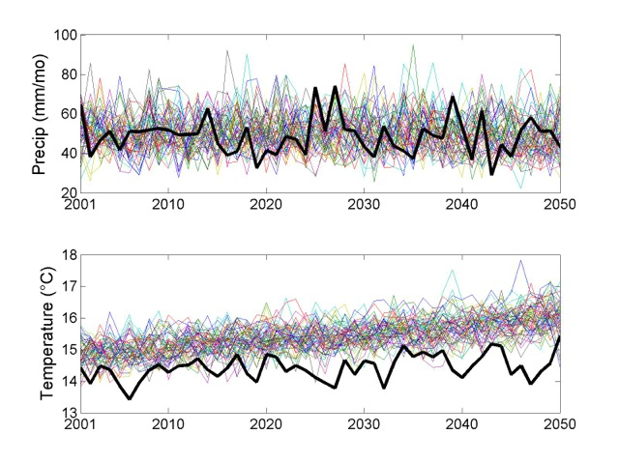
Multiple Climate Projections for the Orange-Senqu
Show T Increasing and P Fluctuating around Mean
Notes:
A wide range of available annual average temperature forecasts, shown here for the Volta basin area

Slide 8
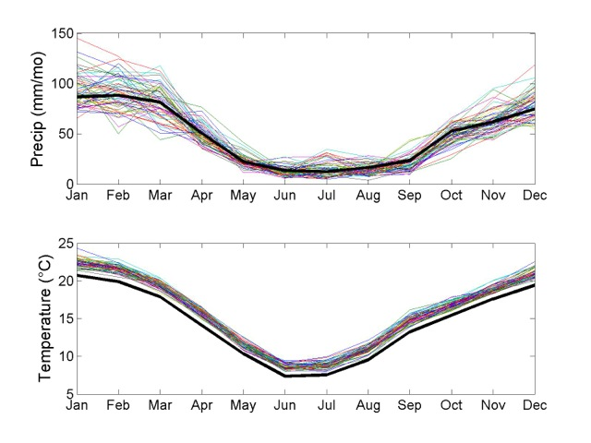
With Similar Patterns When Viewed on a Monthly Basis
Notes:
A wide range of available annual average precipitation forecasts, shown here for the Volta basin area

Slide 9
Traditional Methods Can Backfire in
Such Deeply Uncertain Conditions
“Predict Then Act”
What will future conditions be?
Under those conditions, what is best near-term decision?
How sensitive is the decision to those conditions?
Uncertainties are underestimated
Competing analyses can contribute to gridlock
Misplaced concreteness can blind decisionmakers to surprise

Slide 10
Robust Decision Making (RDM) Works Better Under Deeply Uncertain Conditions by Running the Analysis Backwards
“RDM Process”
Proposed
strategy
Identify vulnerabilities of this strategy
Develop strategy adaptations to reduce vulnerabilities
Start with a proposed strategy
Use multiple model runs to identify conditions that best distinguish futures where strategy does and does not meet its goals
Identify steps that can be taken so strategy may succeed over wider range of futures

Slide 11
RDM Uses Analytics to Facilitate New Conversation with Decision Makers
1. Participatory Scoping
Scenarios and
strategies
New
insights
Vulnerabilities
4. Adaptation Tradeoffs
2. System Evaluation across Many Cases
3. Vulnerability Assessment
Outcomes
Vulnerabilities
and leading strategies
Robust
Strategy
Dialogue
Analysis
Dialogue and Analysis

Slide 12
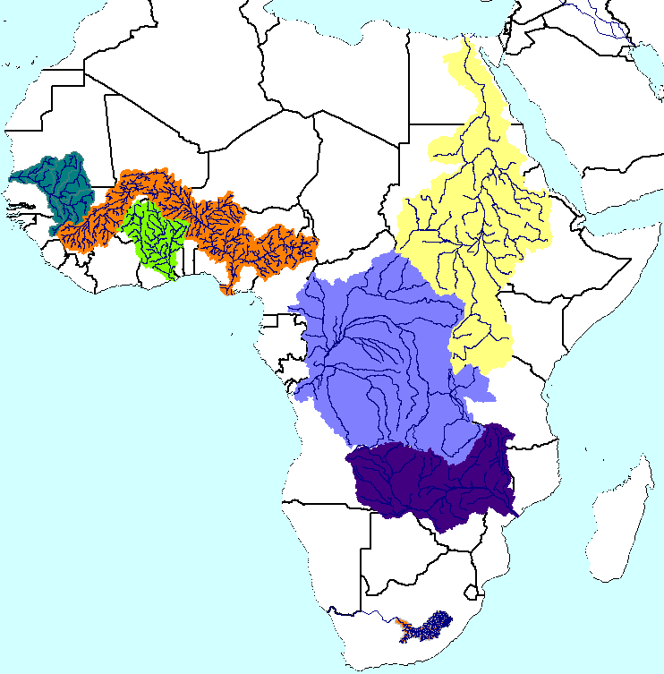
RDM Used to Evaluate PIDA Vulnerabilities and Adaptation Options for the Volta River Basin
Volta
River Basin
Notes:
Volta River Model
Originally developed by IRD and IUCN
Hosted by Volta Basin Authority
Includes:
Domestic water demand for 22 million people and 10.5 cattle
Major irrigation projects and water storage and hydro facilities
Impacts of climate change

Slide 13
Preliminary Scoping of Volta River Basin Analysis
Uncertainties (X) | Water Management Strategies (L)
Climate Temperature Precipitation | PIDA+ Baseline
Model (R) | Performance Metrics (M)
WEAP Volta Model | Domestic unmet demand and reliability Irrigation unmet demand and reliability Livestock unmet demand and reliability Hydropower production and firm yield

Slide 14
PIDA+ Projects Included in the Volta Model
Hydro Power Projects |  | Irrigation Projects
Akosombo | Jambito | Bui Irrigation
Badongo | Juale | Noumbiel Irrigation
Bagre Aval | Koulbi | Pwalugu Irrigation
Bon | Kpong | Sabari Irrigation
Bontioli | Kulpawn | Samendeni Irrigation
Bonvale | Lanka | Nawuni Irrigation
Bui Dam | Noumbiel | Senchi Irrigation
Daboya | Ntereso
Gongourou | Pwalugu

Slide 15
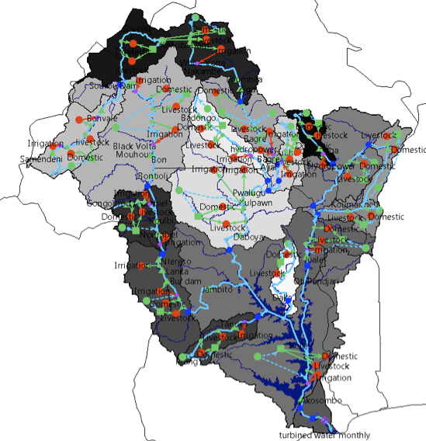
WEAP Volta Model Evaluated System Many Times to Understand Ranges of Climate Impacts
Other adaptation strategies (4)
PIDA+ projects
Climate projections
(57 projections)
Domestic water use
Livestock water use
Agricultural water use
Hydropower
Demand projections (1)
Other
Uncertainties (later analyses)
Run model for hundreds of futures.
Each future represents one set of assumptions about future climate, demand, and other trends
Notes:
WEAP model…

Slide 16
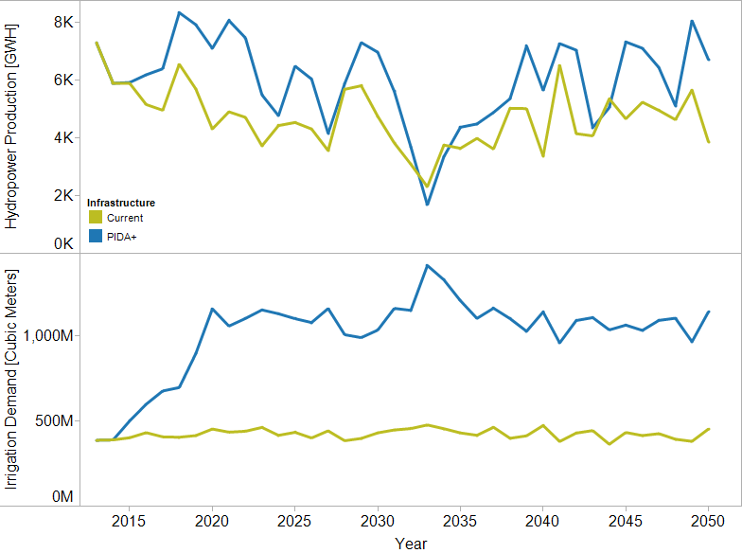
PIDA+ Plans Would Moderately Increase Hydropower Production and Significantly Increase Irrigation Demand Under Historical Climate Conditions
(Very dry historical year)

Slide 17
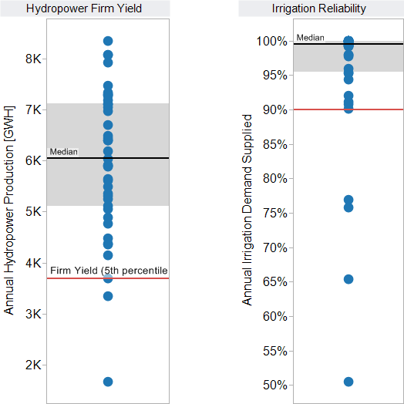
We Summarize Over Years Using
Hydropower Firm Yield and Irrigation Reliability
Hydropower Firm Yield =
Minimum yield in all but 5% of years
Irrigation Reliability = Percentage of years in which 90% of irrigation demand is supplied
37/41 years =
90.2% reliable
Reliability Standard
3,697 GWH
- Historical Climate
- Each dot indicates
results for an individual year

Slide 18
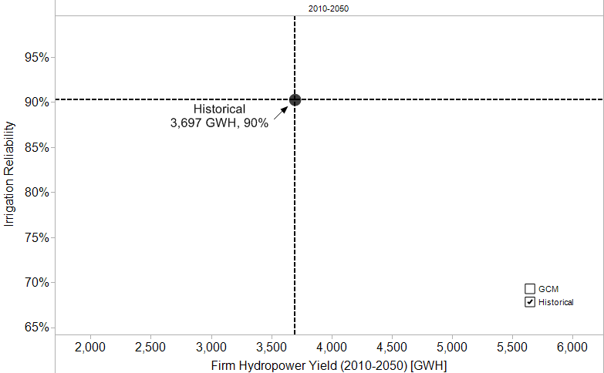
Performance in the Volta Varies Significantly Across GCM Climate Projections
Historical climate

Slide 19
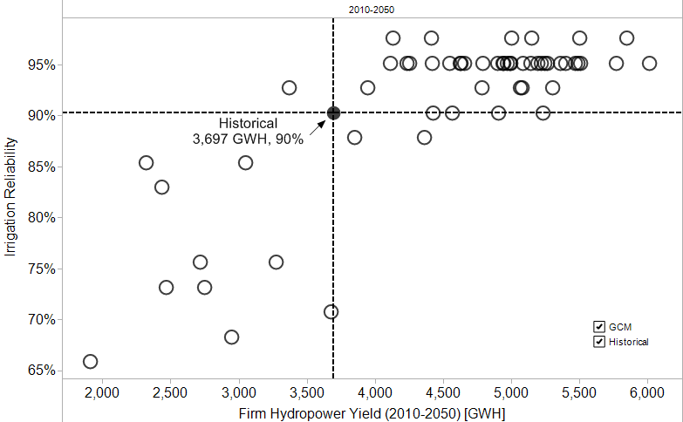
Performance in the Volta Varies Significantly Across GCM Climate Projections
(both sectors okay)
(irrigation okay, hydro
under-performs)
(hydro okay, irrigation
under-performs)
Historical climate +
56 climate projections
(both sectors under-perform)

Slide 20
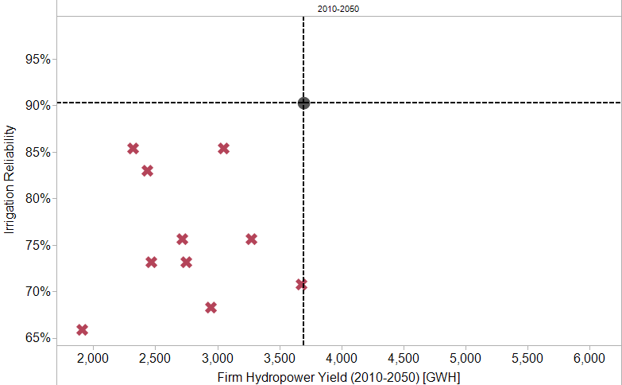
Which Future Climate Conditions Would Lead to Under Performance?
(both sectors under-perform)

Slide 21
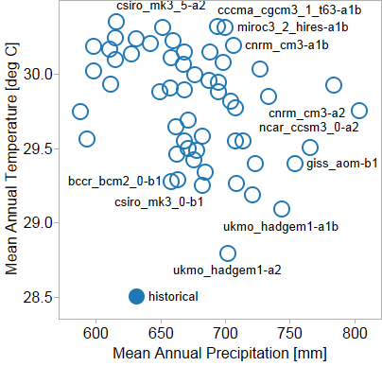
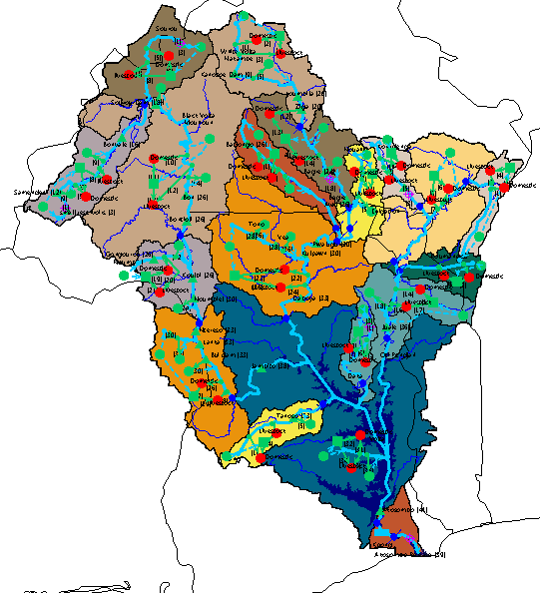
We Evaluated Climate Conditions Across Volta River Basin
Upper Basin (Wayen)

Slide 22
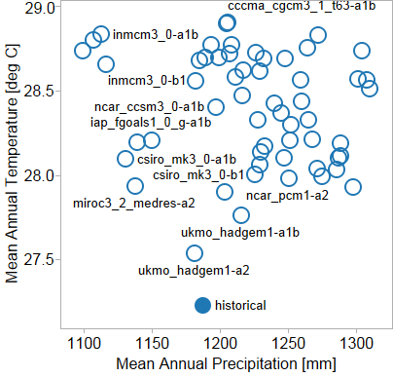
We Evaluated Climate Conditions Across Volta River Basin
Lower Basin (Senchi)

Slide 23
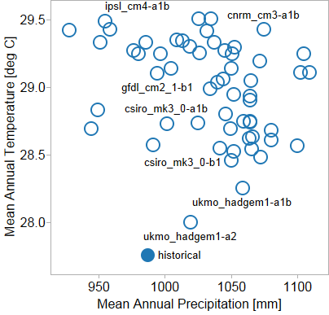
We Evaluated Climate Conditions Across Volta River Basin
Entire Basin (weighted average)

Slide 24
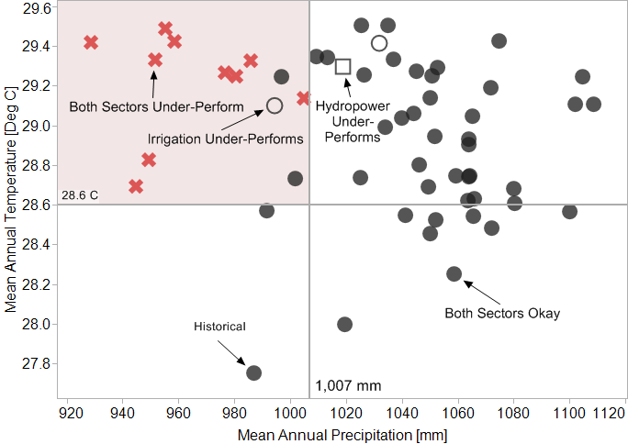
Scenario Discovery Techniques Identify Climate Conditions That Lead to Low Performance
Mean annual precipitation < 1,007 mm &
Mean annual temperature > 28.6 deg C
Entire Basin (weighted average)

Slide 25
The Volta PIDA+ Strategy is Vulnerable to Key Climate Conditions
Vulnerable scenario:
  Mean annual precipitation < 1,007 mm &
  Mean annual temperature > 28.6 deg C
Describes 100% of low performance outcomes(10 of 10)
77% of outcomes are low performance (10 of 13)

Slide 26
Key Vulnerability Suggests New Adaptation Strategies
Uncertainties (X) | Water Management Strategies (L)
Climate Temperature Precipitation | PIDA+ Baseline Adaptation Strategies Increase irrigation efficiency Increase hydropower capacity Prioritize hydropower
Model (R) | Performance Metrics (M)
WEAP Volta Model | Domestic unmet demand and reliability Irrigation unmet demand and reliability Livestock unmet demand and reliability Hydropower production and firm yield

Slide 27
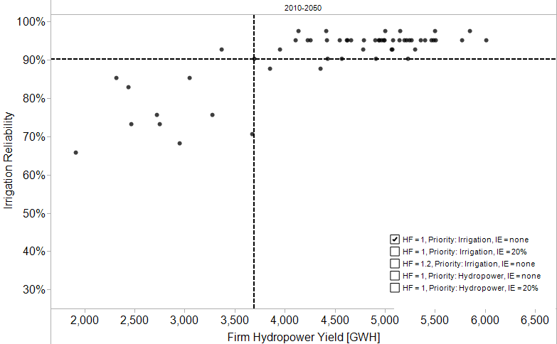
Baseline PIDA+ Strategy Performance Acros 57 Climate Projections
(irrigation okay, hydro
under-performs)
(both sectors okay)
(hydro okay, irrigation
under-performs)
(both sectors under-perform)

Slide 28
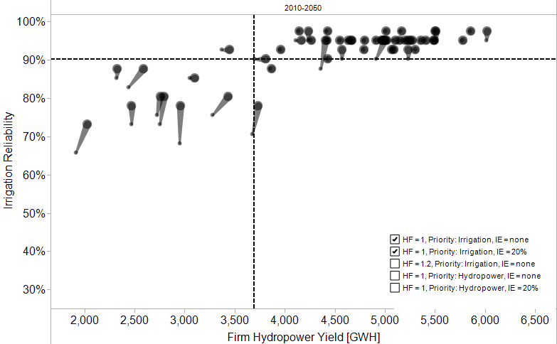
Irrigation Efficiency Improves Irrigation Reliability for Dry Projections
(irrigation okay, hydro
under-performs)
(both sectors okay)
(hydro okay, irrigation
under-performs)
(both sectors under-perform)

Slide 29
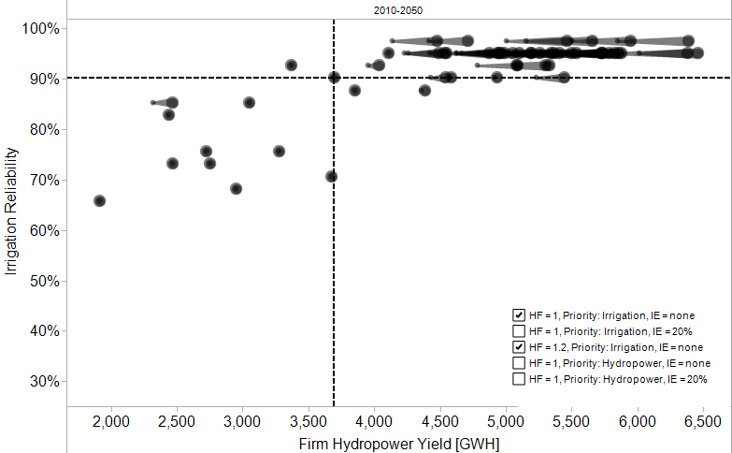
Increased Hydropower Capacity Increases Firm Yield for Wet Projections
(irrigation okay, hydro
under-performs)
(both sectors okay)
(hydro okay, irrigation
under-performs)
(both sectors under-perform)

Slide 30
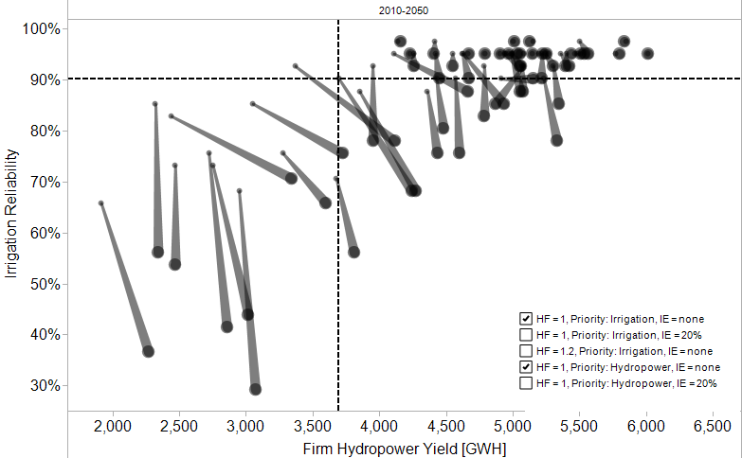
Increased Hydropower Priority Increases Firm Yield but Decreasing Irrigation Reliability
(irrigation okay, hydro
under-performs)
(both sectors okay)
(hydro okay, irrigation
under-performs)
(both sectors under-perform)

Slide 31
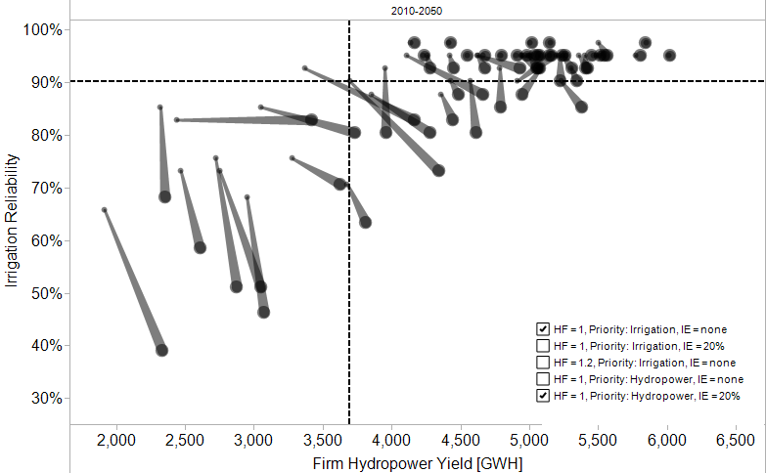
Increased Irrigation Efficiency and Increasing Hydropower Priority Strikes Alternative Balance
(irrigation okay, hydro
under-performs)
(both sectors okay)
(hydro okay, irrigation
under-performs)
(both sectors under-perform)

Slide 32
New Strategies Decrease Some Climate Change Vulnerability with Tradeoffs

Slide 33
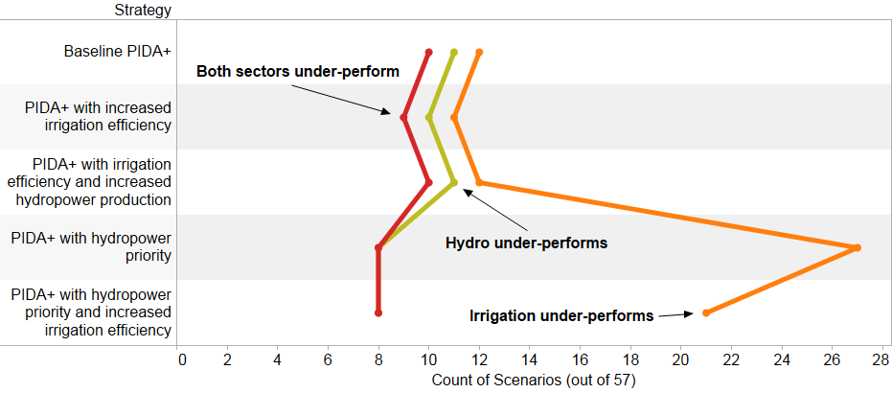
Alternative Strategies Decrease Some Climate Change Vulnerability with Tradeoffs

Slide 34
Next Step for Volta River Basin Analysis
Examine performance in greater detail
  Regionally and by facility
Develop and evaluate additional adaptation strategies
Hold workshop with stakeholders to discuss outcomes and key tradeoffs

Slide 35
Robustness Analysis for Energy
Energy model development is underway
We are developing the robustness analysis structure and components
  Beginning with the SAPP

Slide 36
Energy Modeling Analyzes the PIDA+ Projects
Project name | North–South Power Transmission Corridor | Mphamda-Nkuwa | Lesotho HWP phase II hydropower component
Description | 8,000 km line from Egypt through Sudan, South Sudan, Ethiopia, Kenya, Malawi, Mozambique, Zambia, Zimbabwe to South Africa | Hydroelectric power plant with a capacity of 1,500 MW for export on the SAPP market | Hydropower programme for power supply to Lesotho and power export to South Africa
Power Generation Type | Transmission | Hydro | Hydro
Country | Kenya, Ethiopia, Tanzania, Malawi, Mozambique, Zambia, Zimbabwe, South Africa | Mozambique | ?
Budget ($million) | 6000 | 2400 | 800
Phase | feasibility/needs assessment | feasibility/needs assessment | feasibility/needs assessment
Basin | Nile . Zambezi | Mozambique, Zambezi basin | Orange-Senqu River Basin
Power Pool | Southern African Power Pool | Southern African Power Pool | Southern African Power Pool
Notes:
Remove, mark to give a new one.

Slide 37
Energy Robustness Analysis
RDM
Participatory Scoping
System Evaluation Across Cases
Vulnerability Assessment
Adaptation Tradeoffs
Energy Model
C1
C2
C3
C4
Robust Strategies
Water Model
Vulnerabilities and leading strategies

Slide 38
RDM Structure for the Energy Analysis
Uncertain Factors (X) | Decision Variables (L)
Future Climate Fuel costs Energy demand Cost and performance of energy systems Energy security Greenhouse gas policies | Energy investment in PIDA+ (baseline strategy) Adaptive responses Revised investment timing Enhanced regional integration across power pools Enhanced energy institutions (cost recovery, energy pricing)
Power Pool Models (R) | Objective Variables (M)
Aggregated country-level OSeMOSYS models of power pools (drawing on WEAP analysis) | Financial metrics (cost of power) Energy supply Unserved power demand

Slide 39
Want to Integrate the Water and Energy Analysis Where Feasible
Energy systems rely on water resources
  Hydropower production
  Cooling for many types of power plants
  Irrigation for biofuels
Water management depends on energy systems
  Energy demand for hydropower
  Withdrawals for cooling
We will address this feedback cycle

Slide 40
Step 1 Energy Modeling Influenced by Water,
Step 2 Considers Energy Impacts on Water
Step 1: Power pool/basin studies
  Unidirectional: WEAP informs energy model
Step 2: Project-level studies
  One complete iteration of water-energy feedback
WEAP
Energy model
Optimal investment
WEAP
Energy model
Optimal investment
Water Demand
Re-run WEAP with energy-related water needs—if shortages, re-run energy model

Slide 41
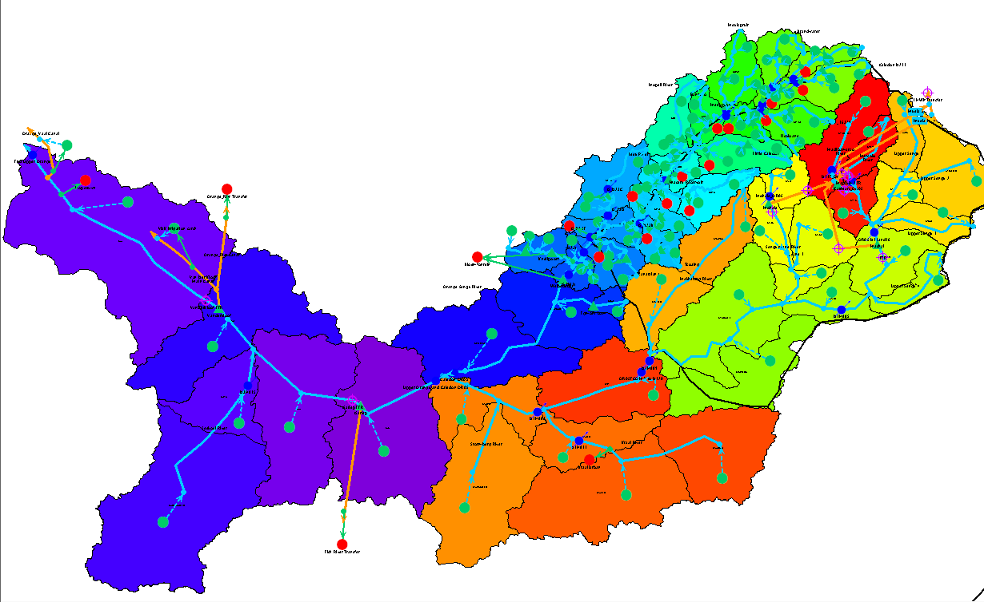
We Have Begun an RDM Analysis for the Orange River Basin

Slide 42
Preliminary Scoping of Orange River Basin Analysis
Uncertainties (X) | Water Management Strategies (L)
Climate Temperature Precipitation | PIDA+ Baseline
Model (R) | Performance Metrics (M)
WEAP Orange Model | Domestic unmet demand and reliability Irrigation unmet demand and reliability Hydropower production and firm yield

Slide 43
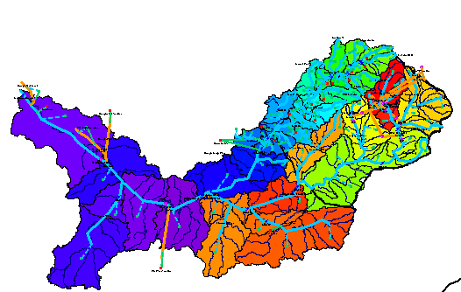
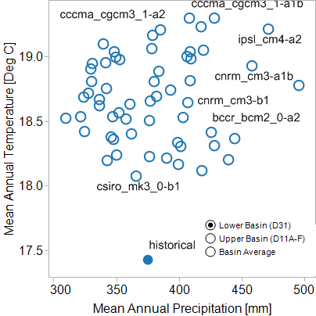
We Evaluated Climate Conditions Across Orange River Basin
Lower Basin (D31)

Slide 44
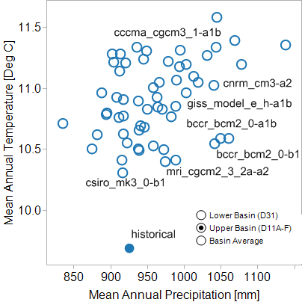
We Evaluated Climate Conditions Across Orange River Basin
Upper Basin (D11A-F)

Slide 45
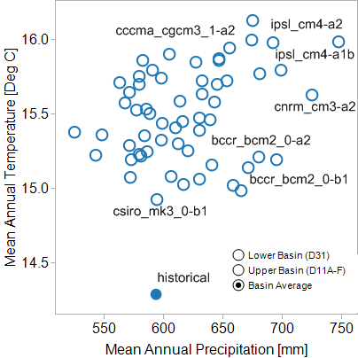
We Evaluated Climate Conditions Across Orange River Basin
Basin Average
Scenario discovery techniques next identify climate conditions that lead to low performance

Slide 46
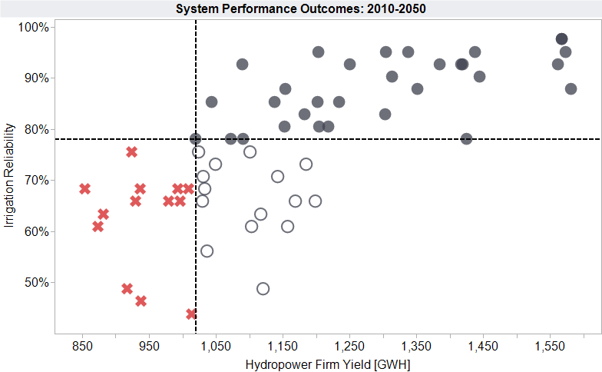
Most Scenarios Show Higher Firm Hydropower Yield and Half Show Higher Irrigation Reliability
(irrigation okay,
hydro under-performs)
(both sectors okay)
13/56 scenarios show lead to low firm hydropower yield and/or low irrigation reliability
(both
sectors
under-
perform)
(hydro okay, irrigation
under-performs)

Slide 47
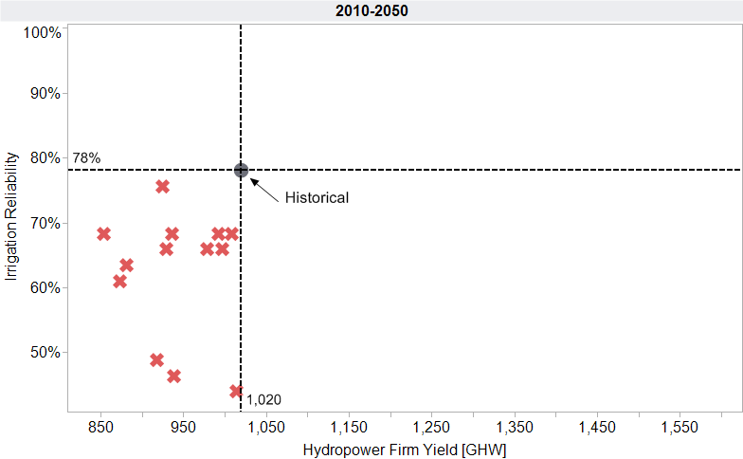
Which Future Climate Conditions
Would Lead to Under Performance?
(both sectors under-perform)

